Slide 1
Quine-McCluskey Method

Slide 2
Let us simplify the following Boolean expression:
f(W,X,Y,Z)=∑m(2,6,8,9,10,11,14,15)
using Quine-McClukey tabular method.
The given Boolean function is in sum of min terms form.
It is having 4 variables W, X, Y & Z.
The given min terms are 2, 6, 8, 9, 10, 11, 14 and 15.
The ascending order of these min terms based on the number of ones present in their binary equivalent is 2, 8, 6, 9, 10, 11, 14 and 15.
The following table shows these min terms and their equivalent binary representations.

Slide 3
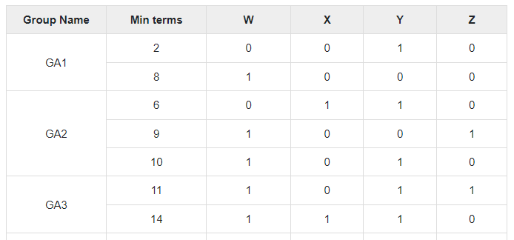
The following table shows these min terms and their equivalent binary representations.
GA4
15
1
1
1
1

Slide 4
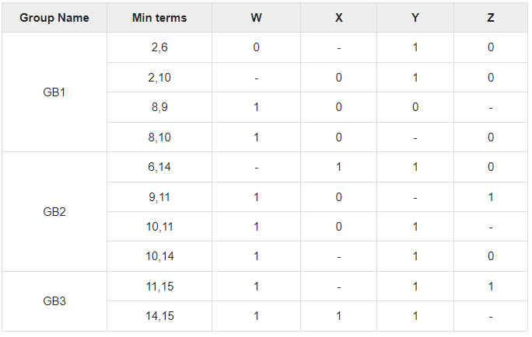
The given min terms are arranged into 4 groups based on the number of ones present in their binary equivalents.
The following table shows the possible merging of min terms from adjacent groups.

Slide 5
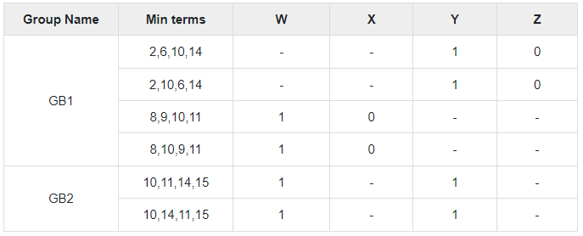
The min terms, which are differed in only one-bit position from adjacent groups are merged.
That differed bit is represented with this symbol, ‘-’.
In this case, there are three groups and each group contains combinations of two min terms.
The following table shows the possible merging of min term pairs from adjacent groups.

Slide 6
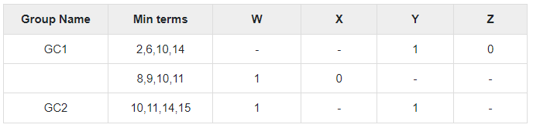
The successive groups of min term pairs, which are differed in only one-bit position are merged.
That differed bit is represented with this symbol, ‘-‘.
In this case, there are two groups and each group contains combinations of four min terms.
Here, these combinations of 4 min terms are available in two rows.
So, we can remove the repeated rows.
The reduced table after removing the redundant rows is shown below.

Slide 7
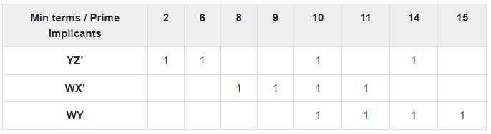
Further merging of the combinations of min terms from adjacent groups is not possible, since they are differed in more than one-bit position.
There are three rows in the above table. So, each row will give one prime implicant.
Therefore, the prime implicants are YZ’, WX’ & WY.
The prime implicant table is shown below.

Slide 8
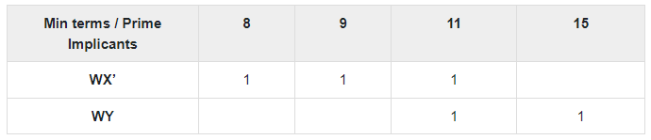
The prime implicants are placed in row wise and min terms are placed in column wise.
1s are placed in the common cells of prime implicant rows and the corresponding min term columns.
The min terms 2 and 6 are covered only by one prime implicant YZ’. So, it is an essential prime implicant.
This will be part of simplified Boolean function.
Now, remove this prime implicant row and the corresponding min term columns.
The reduced prime implicant table is shown below.

Slide 9
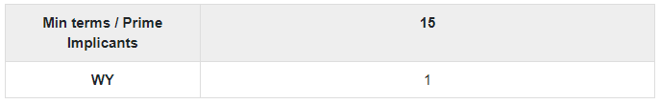
The min terms 8 and 9 are covered only by one prime implicant WX’. So, it is an essential prime implicant.
This will be part of simplified Boolean function.
Now, remove this prime implicant row and the corresponding min term columns.
The reduced prime implicant table is shown below.
The min term 15 is covered only by one prime implicant WY.
So, it is an essential prime implicant. This will be part of simplified Boolean function.
In this example problem, we got three prime implicants and all the three are essential.
Therefore, the simplified Boolean function is.
f (W, X, Y, Z) = YZ’ + WX’ + WY

